Slide 1
Git

Slide 2
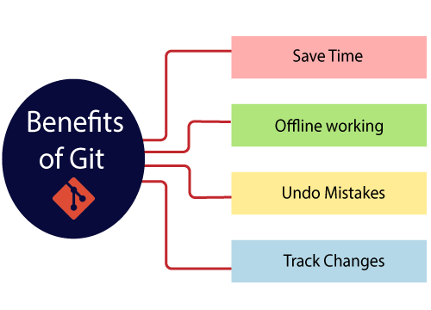
Benefits
source:https://www.javatpoint.com/git

Slide 3
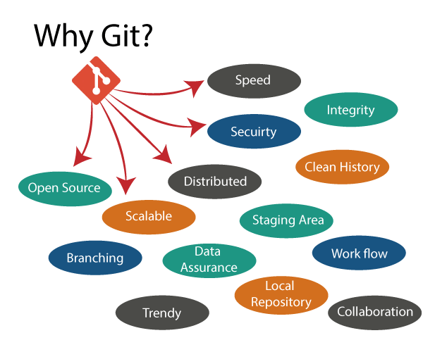
source:https://www.javatpoint.com/git

Slide 4
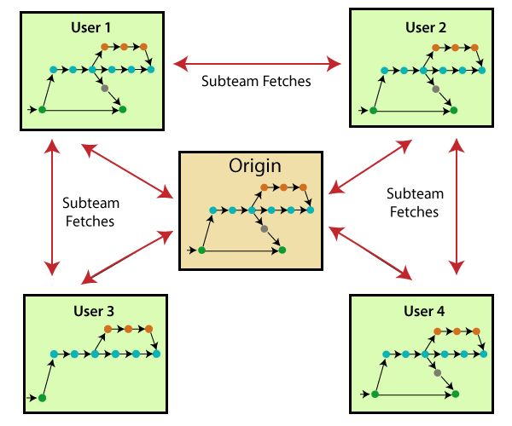
Distributed
source:https://www.javatpoint.com/git

Slide 5
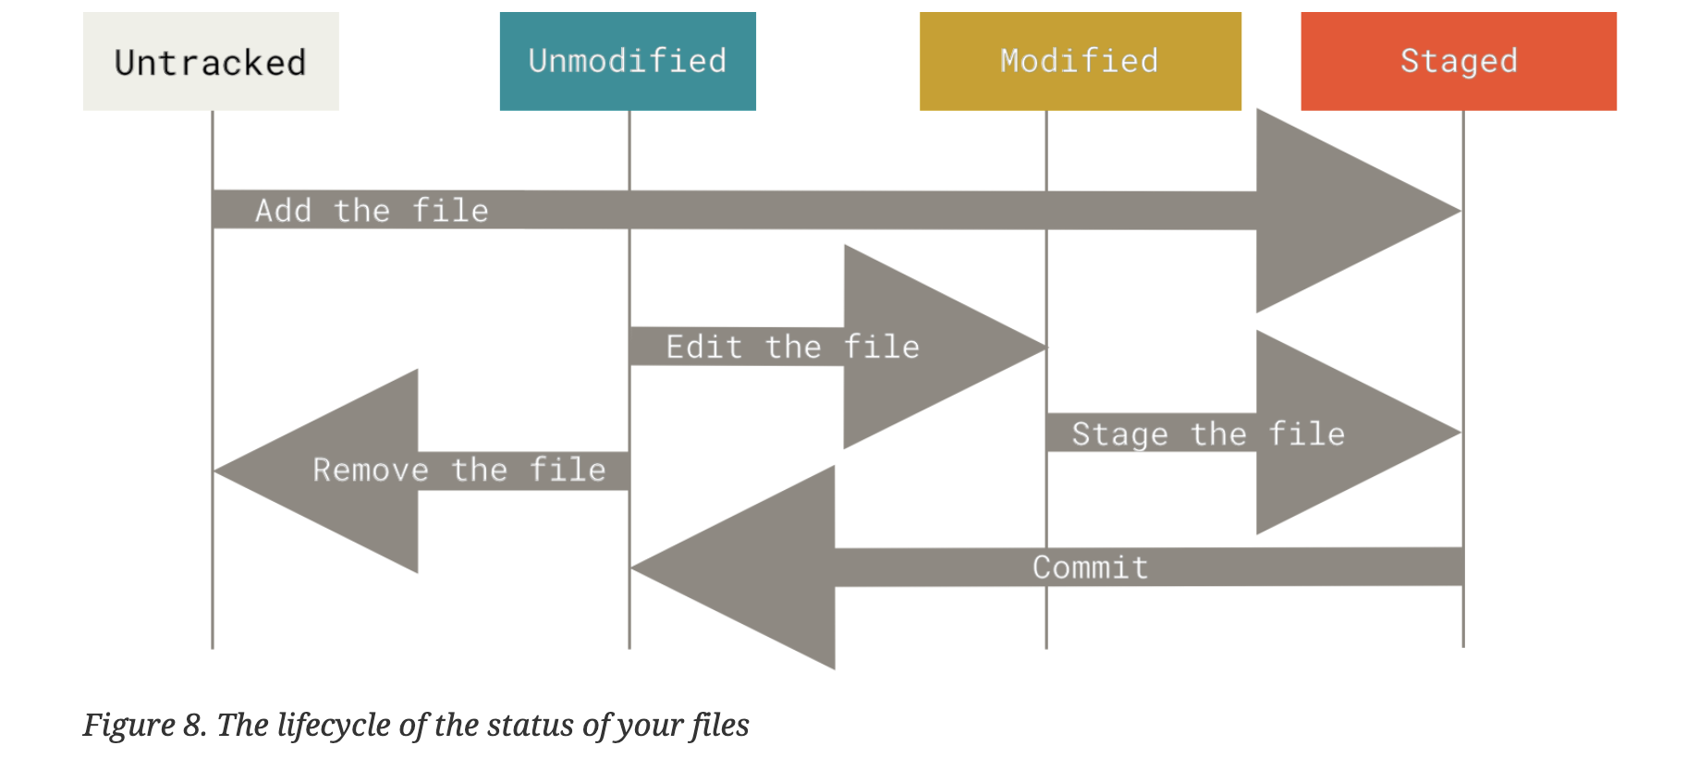
File status Life Cycle
source:Pro git Book

Slide 6
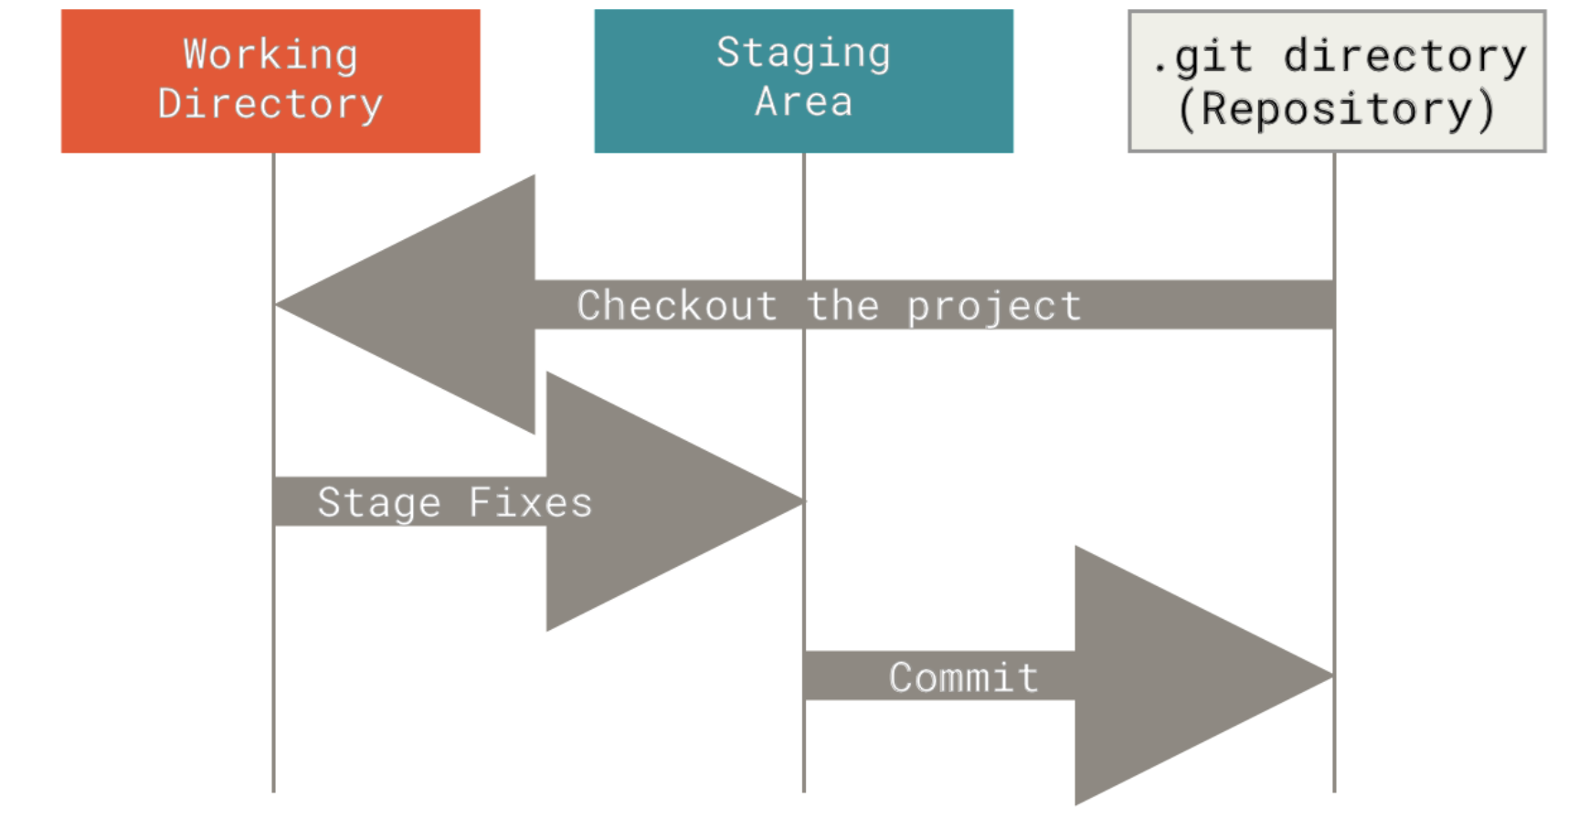
Staging
source:Pro git book

Slide 7
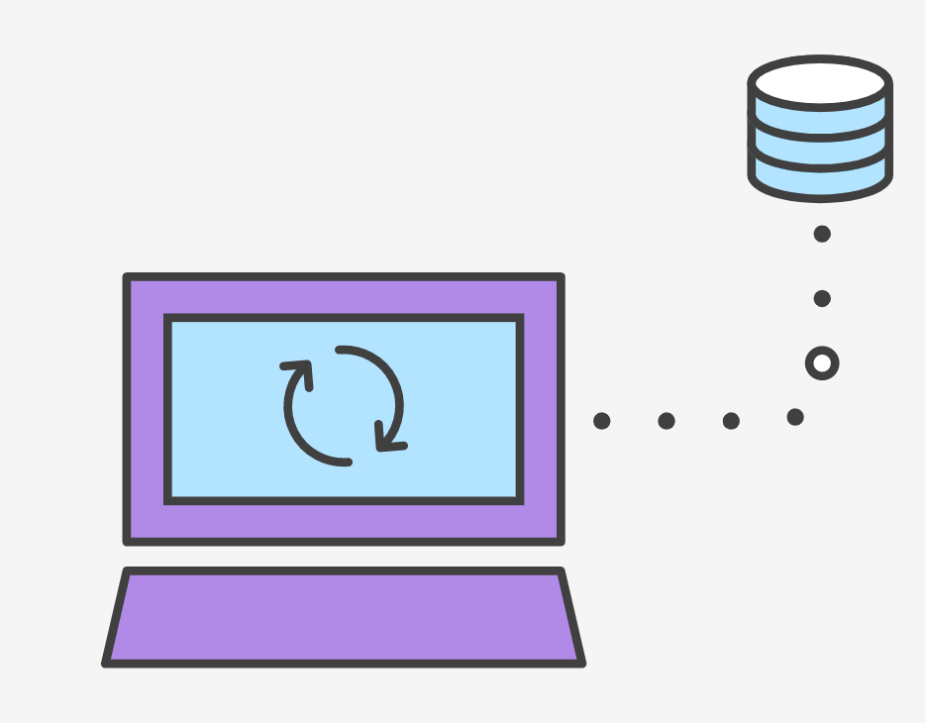
Git Synching
Git Remote
Git Clone
Git Fetch
Git Push
Git Pull
source:https://www.atlassian.com/git/

Slide 8
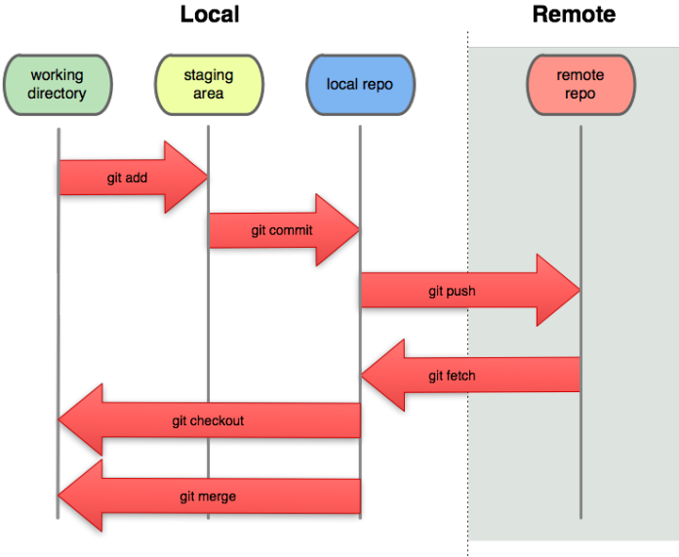
Git Stages
source:https://greenido.files.wordpress.com/2013/07/git-local-remote.png?w=696&h=570

Slide 9
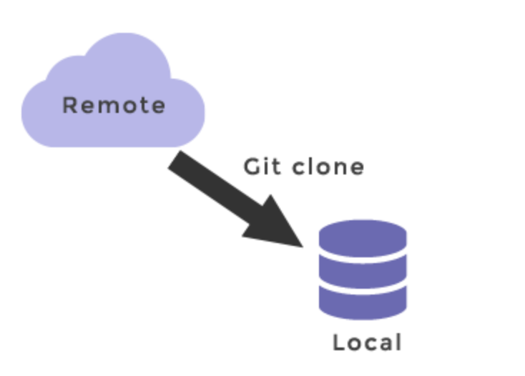
Git Clone
source:https://www.w3docs.com/learn-git/git-clone.html

Slide 10
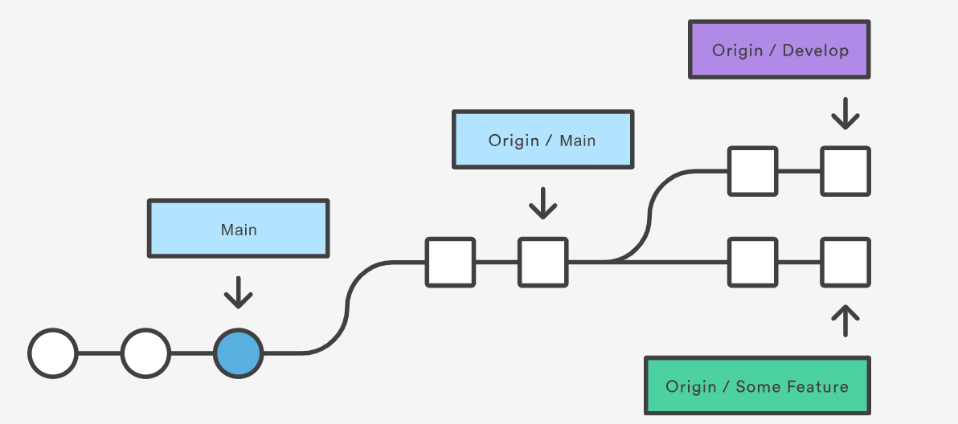
Git Fetch
source:https://www.atlassian.com/git/

Slide 11


Slide 12
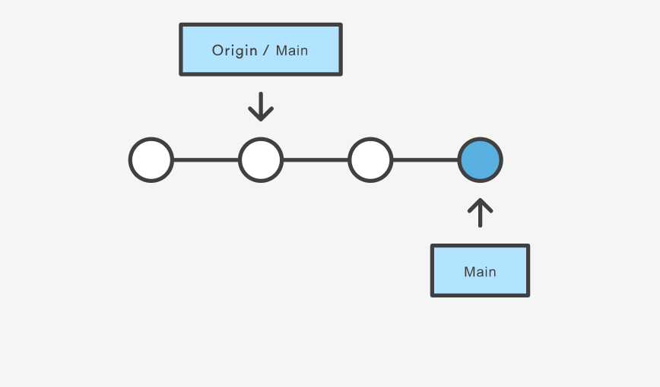
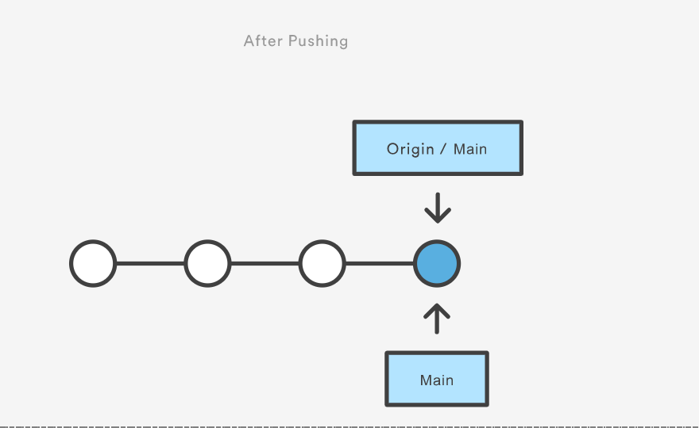
Git Push
Before Pushing
After Pushing
Remote
Remote
Local
Local
source:https://www.atlassian.com/git/

Slide 13
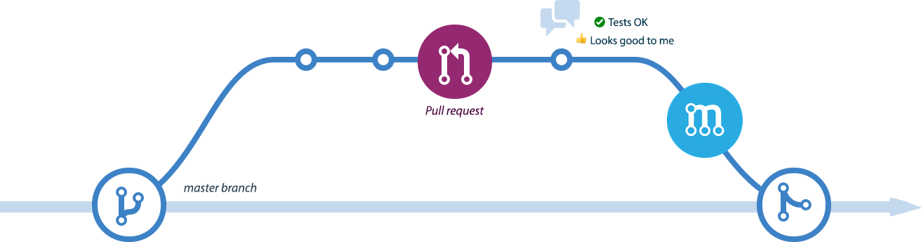
Git Pull Request (Propose Changes)
source:https://medium.com/objectsharp/customizing-pull-requests-c148ca1dcb

Slide 14
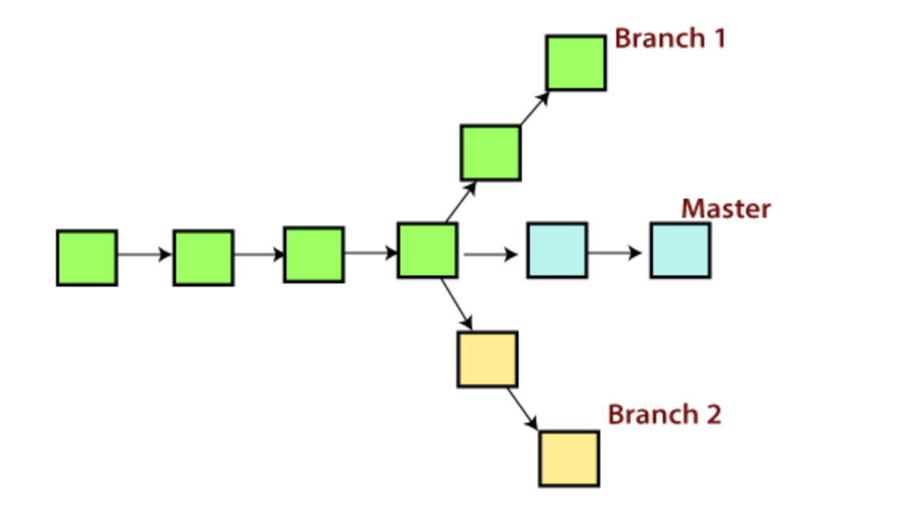
Branching
source:https://www.javatpoint.com/git

Slide 15
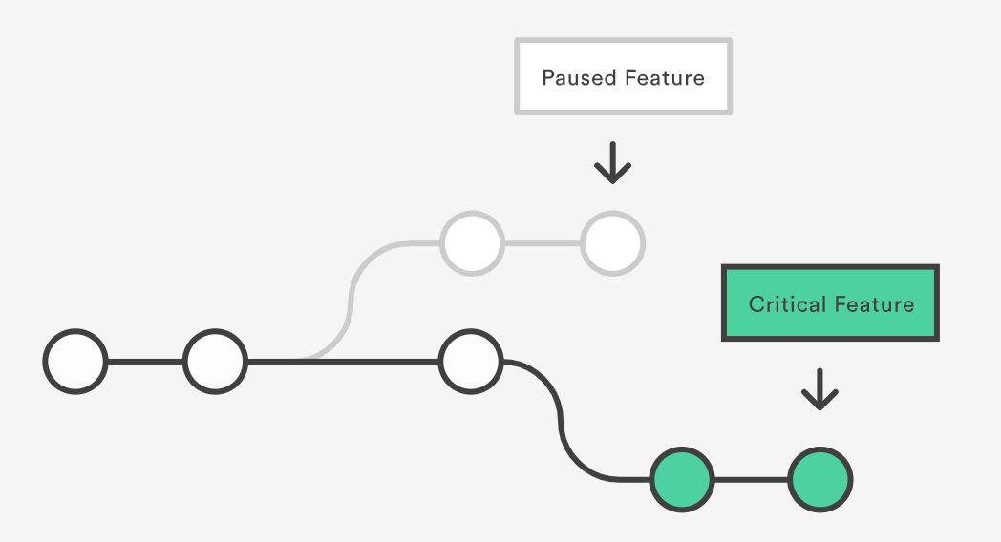
Branching - Git for Product Management
source:https://www.atlassian.com/git/tutorials/why-git

Slide 16
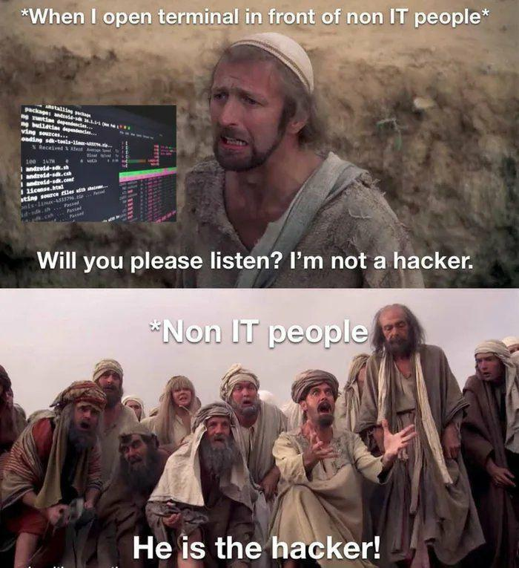
Git Terminal
vs
GitHub Desktop

